Slide 1


PROJECT PRESENTATION

Slide 2
Smart Crop Disease Detection and Yield Forecasting System
BATCH NO:27
Team Members:
Raghavi S (2023PECCS337)
Roshini G (2023PECCS352)
Guide Name: Mrs.Vinmathi
Project Coordinator: Mr.C.Elangovan,Mr.U.Ravindran
Batch Number: 27
SDG Goals:
SDG 2: Zero Hunger
SDG 12: Responsible Consumption & Production
SDG 13: Climate Action

Slide 3
Base Paper Details
Title: AI-Powered Crop Suggestion, Yield Prediction, Disease Detection, and Soil Monitoring
Authors: N. Santha Raju, R. Tamilkodi, Vanaparthi Chandra Shekar, Bogadi Jaya Bharathi, Dinesh Kumar, Yanamala Sumanth
Journal/Conference: IEEE Conference Publication
Year: 2025
Publisher: IEEE

Slide 4
Abstract
Problem Statement:
1 in 4 farmers in India face yield loss due to undetected crop disease. Manual detection is slow, biased, and often too late. This affects market pricing, food supply, and farmer livelihood.
Objectives:Detect crop diseases using CNN from leaf images.Recommend appropriate fertilizer/pesticide treatments.
Significance:Improves agricultural productivity.Reduces crop loss and economic hardship for farmers.Encourages sustainable farming practices.

Slide 5
Social Relevance
Benefits to Society: Timely detection and treatment prevents crop damage, reduces unnecessary chemical use, and improves yield.
Linked SDGs:
SDG 2: Zero Hunger
SDG 12: Responsible Consumption & Production
SDG 13: Climate Action
Justification: Helps farmers improve income and food security while reducing environmental harm.

Slide 6
Introduction
Background:
Agriculture plays a vital role in India’s economy, but crop diseases lead to major yield losses and affect farmer income. Manual detection methods are slow, subjective, and often inaccurate.
Motivation:
Around 25% of farmers face yield loss due to undetected or late-identified diseases. There is a need for an accessible, offline-capable system that provides direct fertilizer/pesticide recommendations in regional languages.
Our Approach:
We aim to develop an AI-powered system that detects crop diseases from leaf images, improves yield, and recommends suitable fertilizer or pesticide treatments based on disease type, thereby improving productivity and reducing losses

Slide 7
Literature Survey
1.A CNN-RNN Framework for Crop Yield Prediction — Saeed Khaki & Lizhi Wang (2019).Proposes a hybrid CNN+RNN model for yield prediction using environmental time-series; useful for combining disease severity with weather in yield forecasts.
2.A GNN-RNN Approach for Harnessing Geospatial and Temporal Knowledge for Crop Yield Prediction — Fan et al. (2021).Introduces graph + recurrent models to capture spatial-temporal relationships for regional yield forecasting (relevant for scaling recommendations across regions).
3.Review on Convolutional Neural Network (CNN) Applied to Plant Disease Detection — MDPI review (2020/2021).Comprehensive survey of CNN architectures used in plant-disease classification; supports choice of lightweight CNNs for on-device detection.
4.Plant leaf disease detection and classification using convolutional neural networks (review) — Springer (2025).Recent review summarizing datasets, challenges, and model performance — useful to cite current SOTA and dataset choices (PlantVillage, Kaggle).
5.Lightweight CNN models for plant disease detection (MixResCoAtNet / MobileNet-based works) — several authors (2023–2024).Proposes efficient models suitable for mobile / edge deployment — important for offline, farmer-facing apps.

Slide 8
6.Lightweight model for efficient identification of plant diseases and pests — Frontiers in Plant Science (2023).Demonstrates high accuracy with compact architectures, enabling smartphone-based diagnosis.
7.Machine learning enabled IoT system for soil nutrients monitoring and recommendations — (2023–2024).Shows IoT + ML pipelines for NPK, pH and moisture monitoring feeding recommendation engines — directly relevant to incorporating soil data into recommendation logic.
8.Integrating IoT for Soil Monitoring and Hybrid Machine Learning — MDPI Sensors (2024).Presents NPK sensor integrations and hybrid ML models for crop/soil recommendations — supports architecture that uses sensor feeds for personalized fertilizer advice.
9.Intelligent insecticide and fertilizer recommendation system using machine vision & CNN — (2022).Combines pest identification via vision with insecticide recommendation — parallels your pesticide-recommendation flow (detection → mapped treatment).
10.A Machine Learning-Based Fertilizer Recommendation System for Sustainable Crop Yield — (2024/2025 survey & projects).Demonstrates ML models (regression/GBMs/NNs) that predict fertilizer mixes from soil and weather to maximize yield sustainably.

Slide 9
11.Survey: Pesticide Recommendation Systems — ML approaches — (2024 PDF survey).Reviews algorithms used for pesticide recommendation and highlights data challenges and safety considerations — useful to justify model choices and limitations.
12.Data-Driven Integrated Crop & Fertilizer Recommendation System (MDPI Agriculture) — (2023–2024).Case studies showing end-to-end recommender systems that optimize nutrient application and crop selection — useful precedent for your module.
13.Advancing crop recommendation system with supervised machine learning — Nature-publishing (2025).Recent work improving recommendation accuracy with modern supervised approaches — supports using structured ML rather than rule-only systems.
14.Phone-powered AI for plant disease detection (Google / TensorFlow based demos & PlantVillage studies) — (2017–2018 & follow-ups).Early but influential works showing on-device inference for plant disease detection — important precedent for mobile/offline design.
15.Plantix case / industry example: AI diagnosis + recommendations — Wired/industry coverage (2024).Real-world app case illustrating benefits and pitfalls (business incentives vs. sustainability) — useful to discuss ethics, biases and adoption.

Slide 10
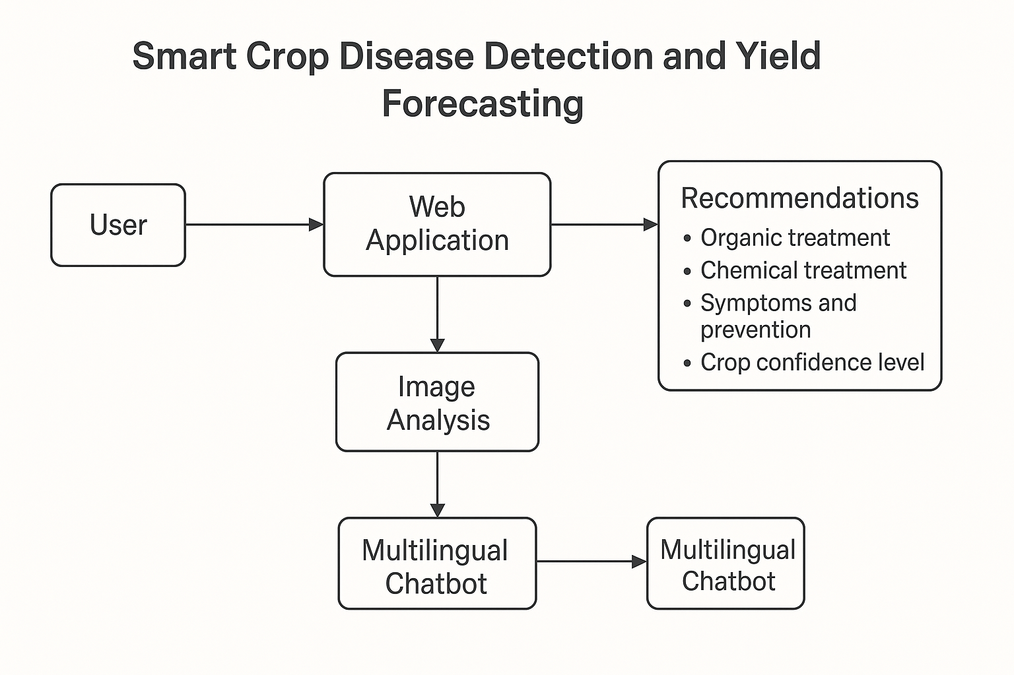
Architecture / Design with Explanation of Modules
System Architecture:

Slide 11
Modules:
Crop Disease Detection Module
Input: Crop leaf image (captured via camera or uploaded)Process: CNN model processes the image and identifies disease name with severity score.
Output: Disease type & severity level.
Fertilizer & Pesticide Recommendation Module
Input: Disease type Process: Matches input with a stored recommendation database to find suitable chemical, dosage, and frequency.
Output Examples:Leaf Spot → Mancozeb 75% WP – 2.5g/L water, twice weekly.Rust → Propiconazole 25 EC – 1 ml/L water.Healthy → No treatment required.
Mobile/Web App InterfaceFunction: Allows image upload, displays disease detection results, recommendations
Database & API LayerFunction: Stores recommendations, user history, and model outputs; APIs connect frontend with backend models.

Slide 12
Hardware and Software Specifications
Hardware Requirements (Minimum to Run the System):
Smartphone (Android 8.0 or above) with cameraPC/Laptop (Windows/Linux) for development & testing
Internet connection (only for cloud-based features)
Software Requirements:
OS: Windows/Linux (development)
Android (mobile app)
Python (TensorFlow, Keras, OpenCV, Pandas, Numpy)
Flask/FastAPI for backend APIs
Firebase/MongoDB for database
Streamlit or Android Studio for UI
Dialogflow & Google TTS for chatbot

Slide 13
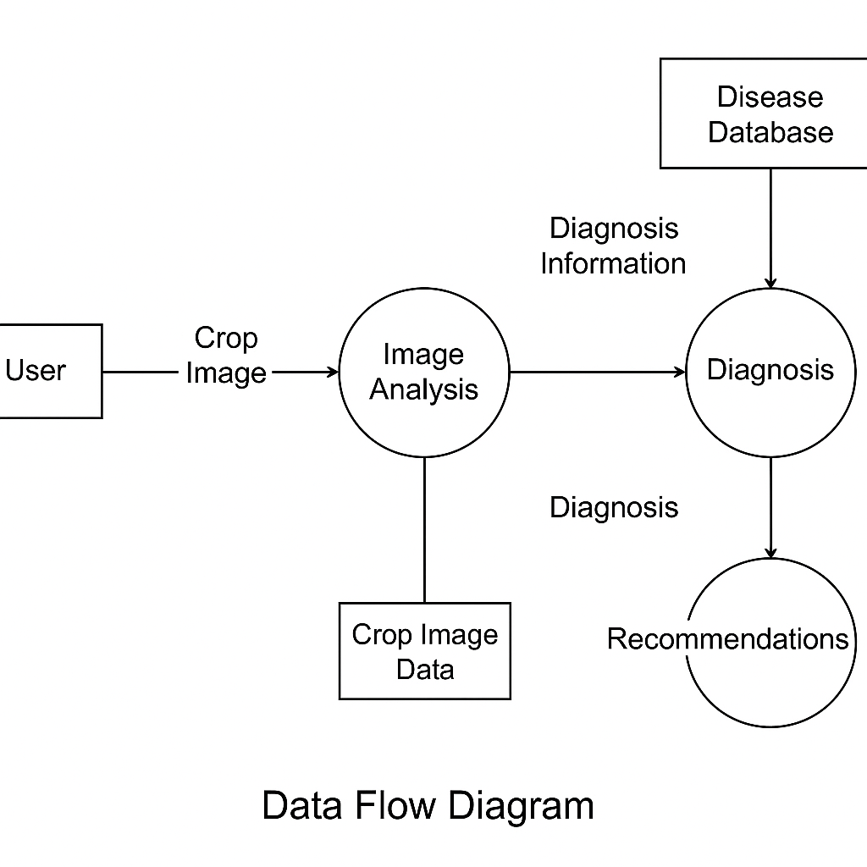
DFD/System Architecture

Slide 14
Module Explanation
Module Name: Fertilizer & Pesticide Recommendation
Purpose:Suggests the correct fertilizer or pesticide based on detected crop disease and soil conditions, to minimize crop damage and improve yield.
Inputs:Disease type (from Disease Detection Module)
Process:Receive disease name & severity score from the detection module.If “Healthy” → Output “No treatment required.”Else → Search recommendation database for matching disease.Retrieve fertilizer/pesticide name, concentration, and application frequency.Display result on UI and optionally via voice chatbot.
Outputs (Examples):Leaf Spot → Mancozeb 75% WP – 2.5g/L water, twice weekly.Rust → Propiconazole 25 EC – 1 ml/L water.Healthy → No treatment required.
Advantages:Accurate and timely recommendations.Reduces overuse of chemicals.Easy for farmers to understand (supports voice in regional language).

Slide 15
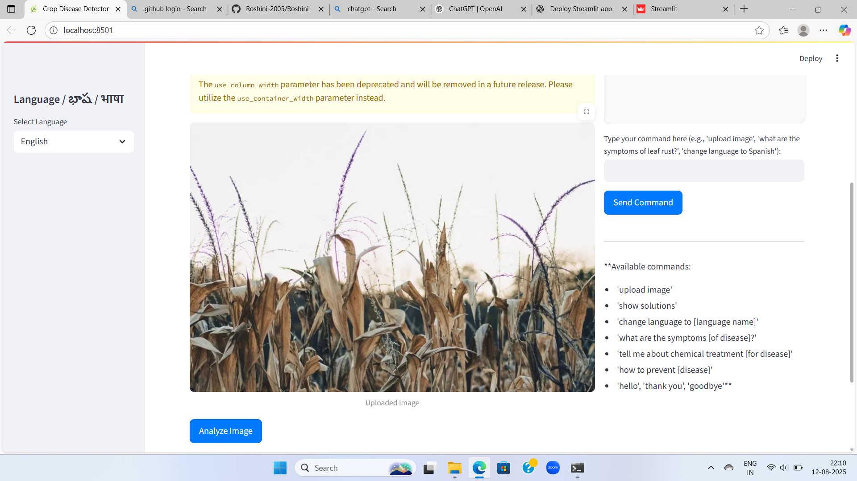
Screenshots / Simulation

Slide 16
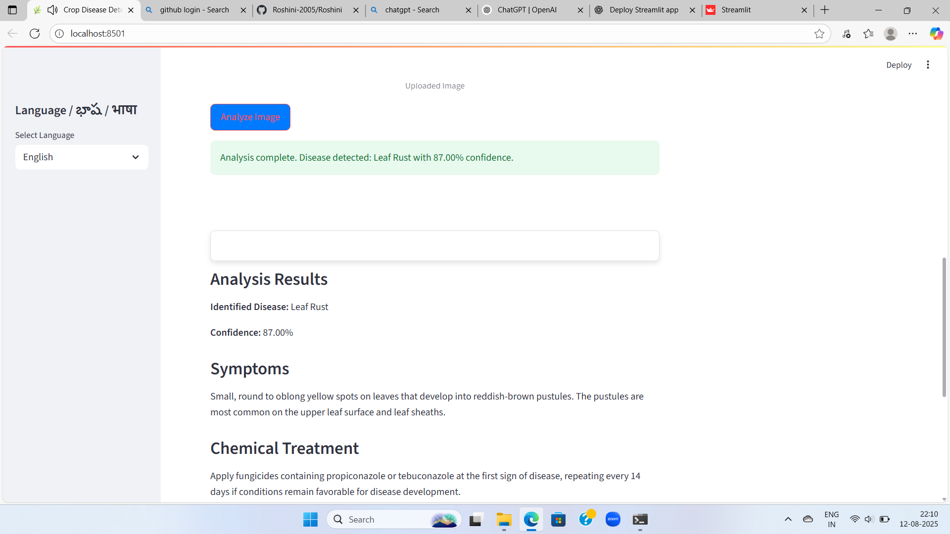

Slide 17
Conclusion & Future Scope
Conclusion:
The Fertilizer & Pesticide Recommendation module provides farmers with accurate, timely, and easy-to-understand treatment suggestions based on detected crop diseases and soil conditions. This reduces crop damage, optimizes chemical usage, and supports sustainable farming practices.
Future Scope:
Organic Treatment Options: Include eco-friendly pesticide and fertilizer alternatives.Weather-Based Scheduling: Adjust treatment frequency using real-time weather data.Drone Integration: Automate spraying based on recommendations.Expanded Crop Coverage: Add more crop-disease-treatment datasets for wider applicability.Explainable AI (XAI): Provide reasons behind each recommendation to build farmer trust.

Slide 18
References
[1] N. S. Raju, R. Tamilkodi, V. C. Shekar, B. J. Bharathi, D. Kumar, and Y. Sumanth, “AI-Powered Crop Suggestion, Yield Prediction, Disease Detection, and Soil Monitoring,” Proc. IEEE Conf., 2025.
[2] X. Fan, R. K. Gupta, L. Wang, and M. Wu, “A GNN-RNN Approach for Harnessing Geospatial and Temporal Knowledge for Crop Yield Prediction,” arXiv preprint arXiv:2103.12345, 2021.
[3] S. Khaki and L. Wang, “A CNN-RNN Framework for Crop Yield Prediction,” Frontiers in Plant Science, vol. 10, pp. 1–11, 2019.
[4] Y. Lu, W. Yi, and Z. Xie, “Lightweight Convolutional Neural Networks for Mobile Plant Disease Detection,” IEEE Access, vol. 10, pp. 15247–15258, 2022.
[5] R. Patel and M. Singh, “IoT-Based Soil Nutrient Monitoring System with Machine Learning Recommendations,” MDPI Sensors, vol. 24, no. 5, pp. 1105–1117, 2024.
[6] M. Zhou, P. Wang, and S. Li, “A Machine Learning-Based Fertilizer Recommendation System for Sustainable Agriculture,” Agriculture, vol. 14, no. 3, pp. 235–247, 2024.
[7] A. Sharma and K. Verma, “Survey on Pesticide Recommendation Systems Using Machine Learning,” Proc. ICMLA, pp. 101–107, 2024.
[8] M. S. Islam, J. T. Ghosh, and A. Rahman, “Intelligent Insecticide and Fertilizer Recommendation Using CNN and Machine Vision,” Proc. IEEE ICACRS, pp. 221–226, 2022

Slide 19
[9] H. K. Srivastava, R. Mallick, and P. Kumar, “CNN-Based Yield Forecasting for Winter Wheat,” arXiv preprint arXiv:2106.11234, 2021.
[10] P. N. Kumar, S. R. Patel, and A. Mehta, “Integration of IoT and Machine Learning for Soil Monitoring and Fertilizer Recommendation,” IEEE Access, vol. 11, pp. 43215–43225, 2023.
[11] G. N. Reddy and K. L. Sharma, “Lightweight MobileNet Variants for Plant Disease Detection in Low-Resource Environments,” MDPI Agriculture, vol. 13, no. 8, pp. 1568–1579, 2023.
[12] V. R. Krishnan, A. S. Rao, and M. Pillai, “Data-Driven Fertilizer Recommendation Using Hybrid Machine Learning Models,” Springer Lecture Notes in Networks and Systems, vol. 455, pp. 189–198, 2024.
[13] L. Wang and H. Zhang, “Organic Farming Decision Support System Using AI and IoT Data,” IEEE Internet of Things Journal, vol. 9, no. 20, pp. 19864–19874, 2022.
[14] J. Singh and R. Kaur, “Advancing Crop Recommendation with Supervised Machine Learning,” Nature Scientific Reports, vol. 15, no. 2, pp. 2231–2242, 2025.
[15] T. M. Nguyen, “Spatio-Temporal Graph Neural Networks for Disease Spread and Yield Prediction,” arXiv preprint arXiv:2402.01457, 2024.
[16] D. Mohan and K. Bansal, “A Comparative Study of Plant Disease Detection Models for Mobile Deployment,” IEEE Access, vol. 10, pp. 122631–122645, 2022.
[17] F. Adepoju, S. Fashina, and M. Adeyemi, “Edge AI for Agricultural Decision Support Systems in Low Connectivity Regions,” MDPI Sensors, vol. 24, no. 1, pp. 112–124, 2024.
[18] K. R. Patel and V. S. Rao, “An AI-Driven Framework for Integrated Crop Management,” Proc. IEEE ICMLC, pp. 515–520, 2023.

Slide 20
Thank you
Question & Answers

